Slide 1
WSLab Datacenter Simulation - Scenarios
Jaromir Kaspar
Sr. Premier Field Engineer, Microsoft
aka.ms/wslab
@jaromirkaspar

Slide 2
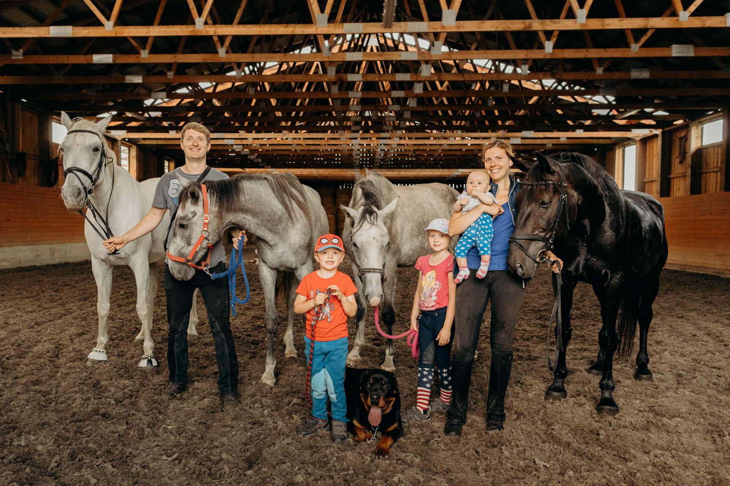
About me
Almost 8 years in Microsoft
Main focus: AzSHCI
Main skills: Windows Server, PowerShell

Slide 3

Why “scenarios”
Most of Lab tools give you only half – the infrastructure to play with
Every time you use RDP, baby seal dies!

Slide 4
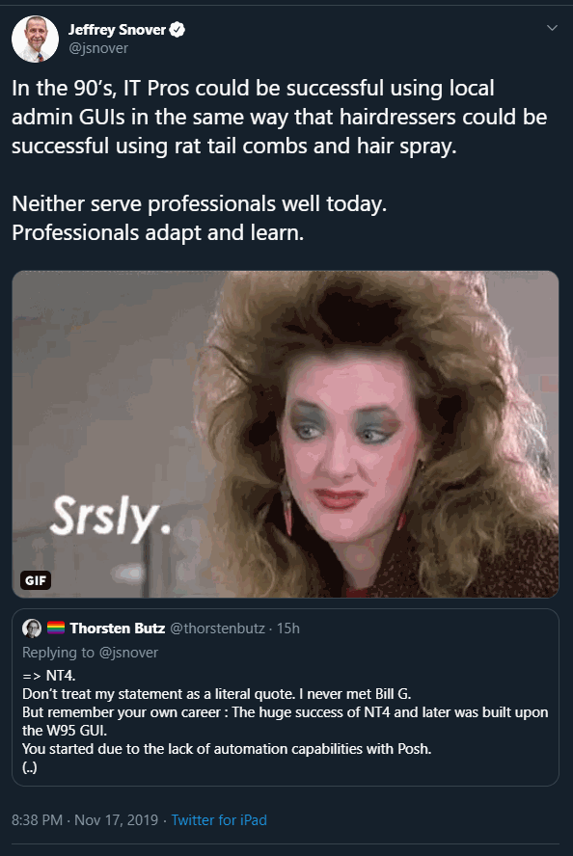
Why “scenarios”

Slide 5
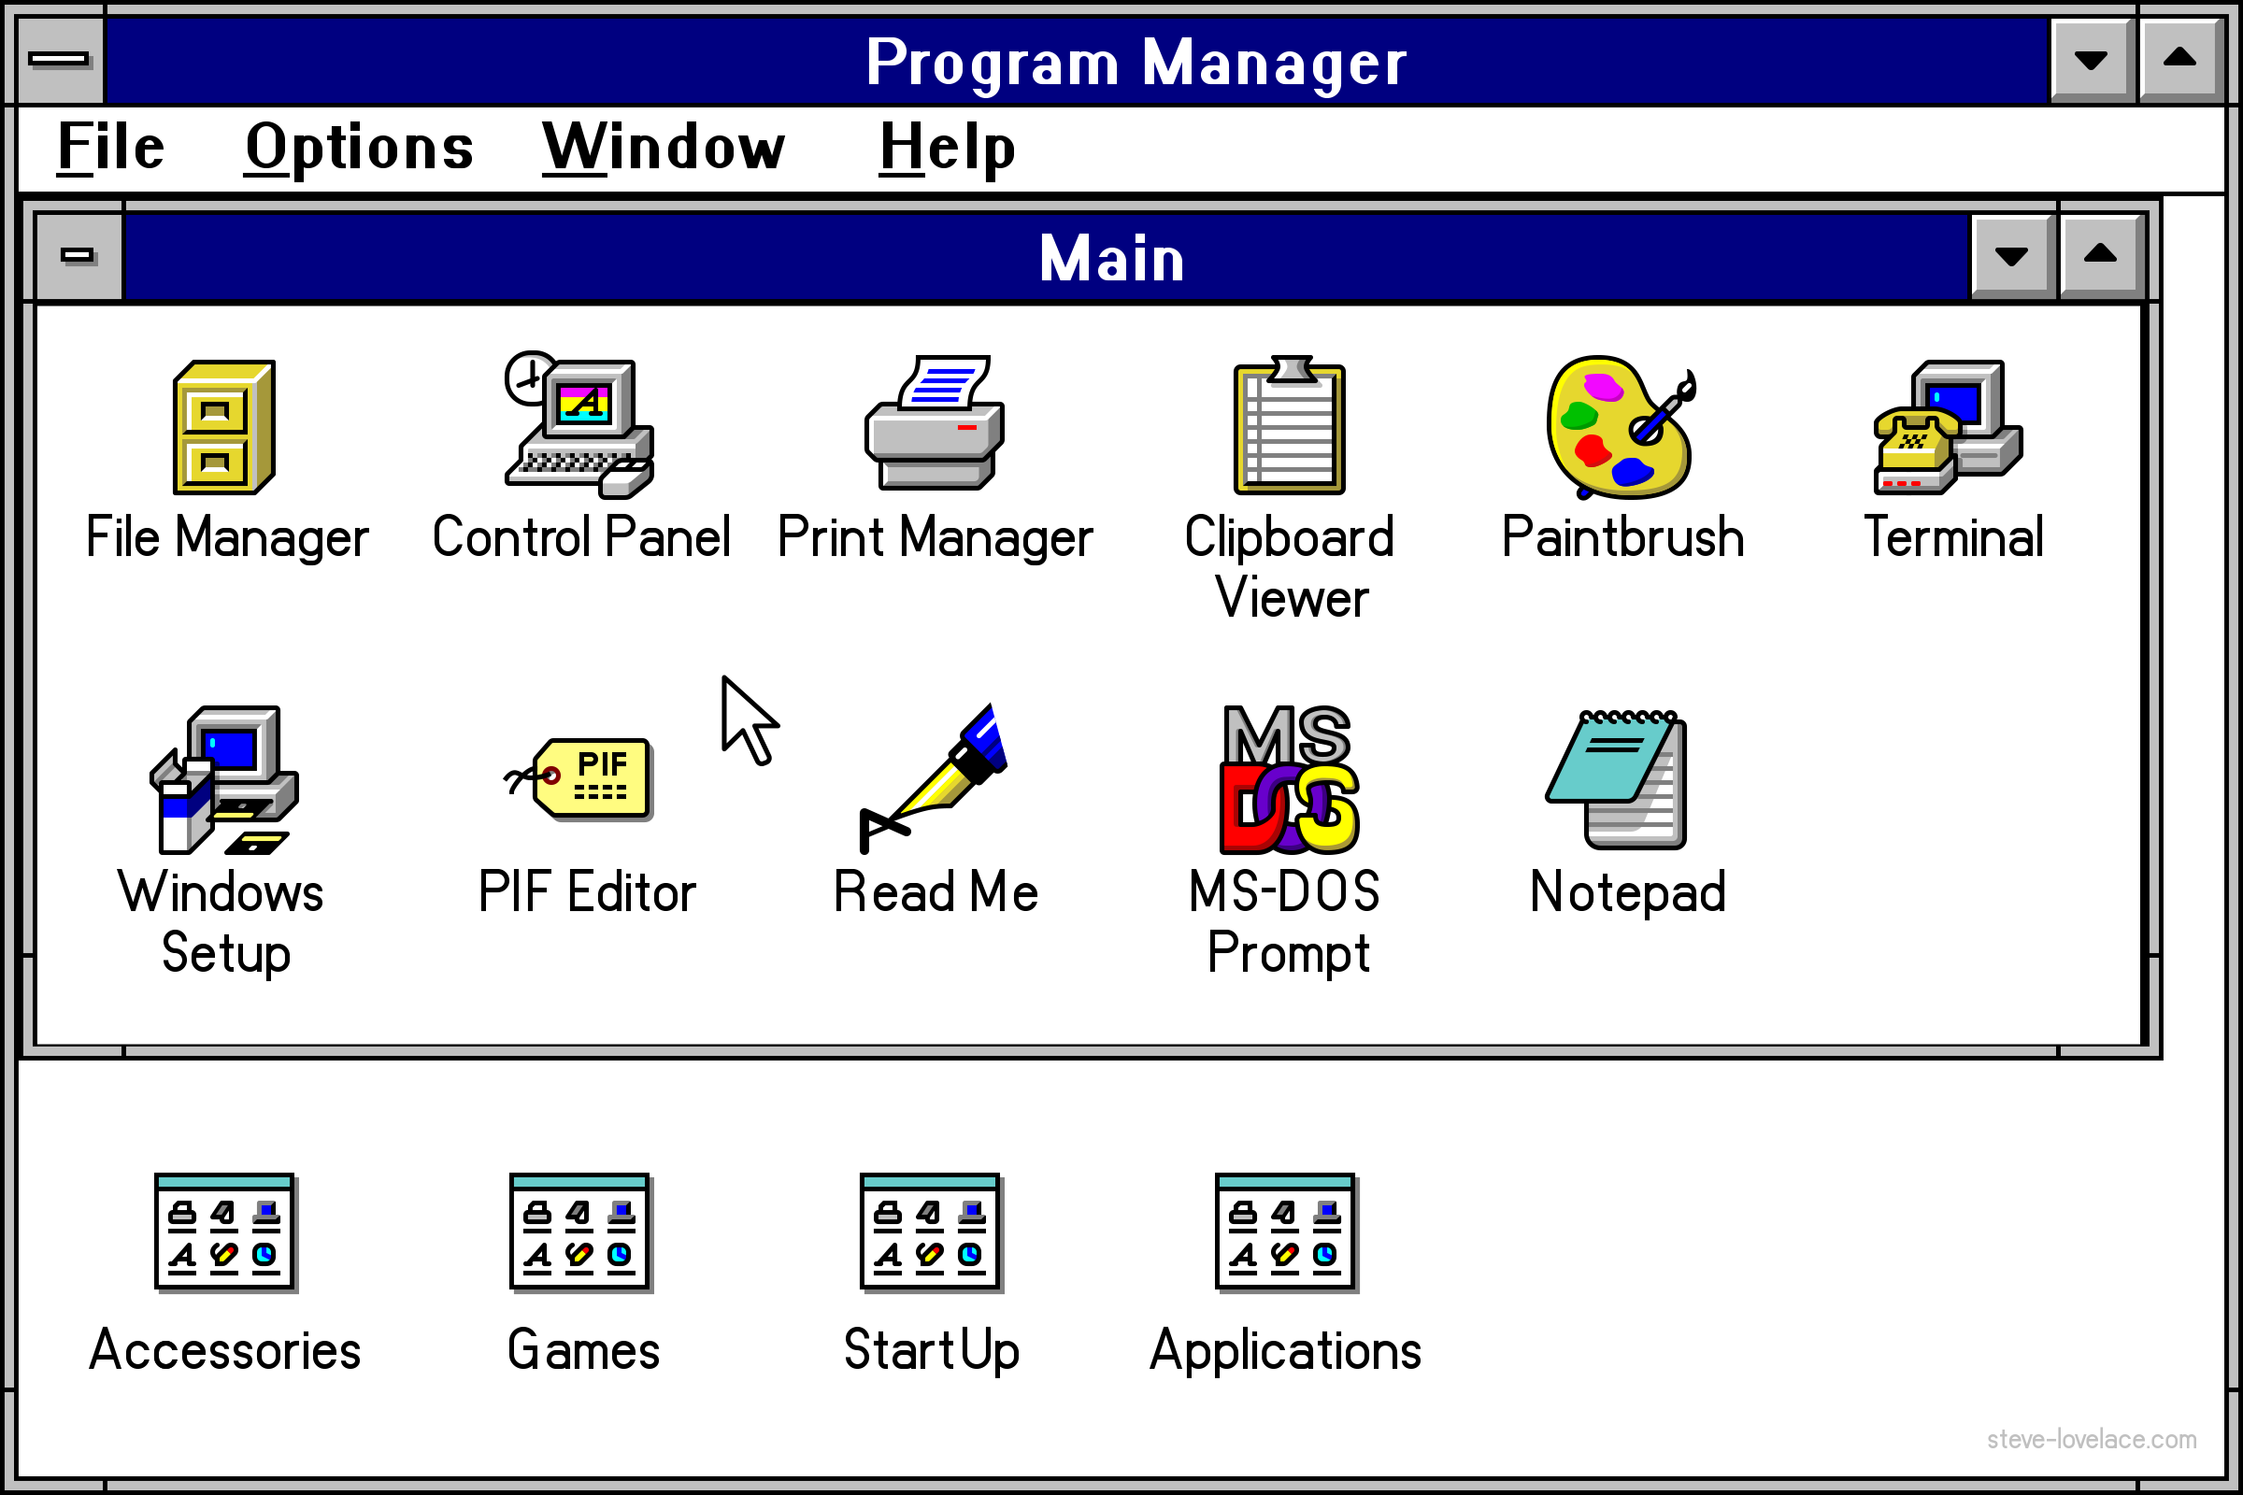
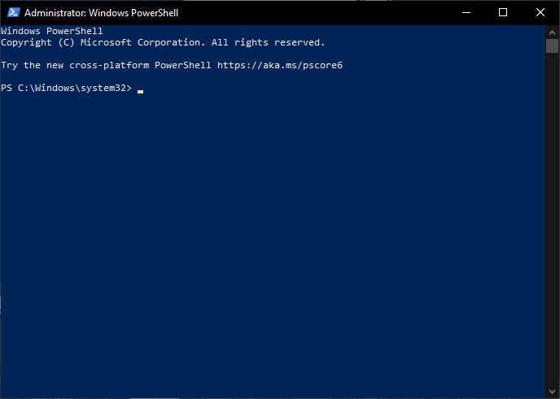
Admin tools
This is past!
(same as comic sans)

Slide 6
“PowerShell is scary – I don’t understand it”
Quiz time!

Slide 7
What does this command?
Install-WindowsFeature -Name RSAT -IncludeAllSubFeature

Slide 8
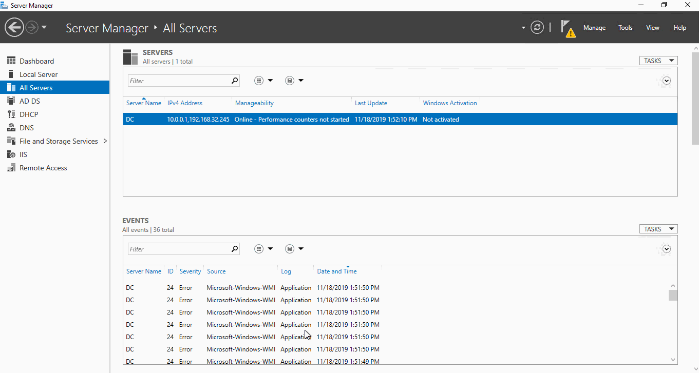
What does this command?

Slide 9
“Can you create documentation?”
Smart Admin
Admin from the past

Slide 10
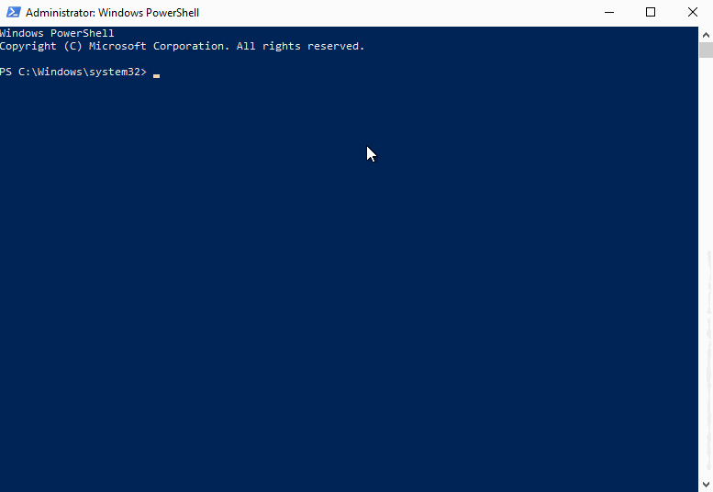
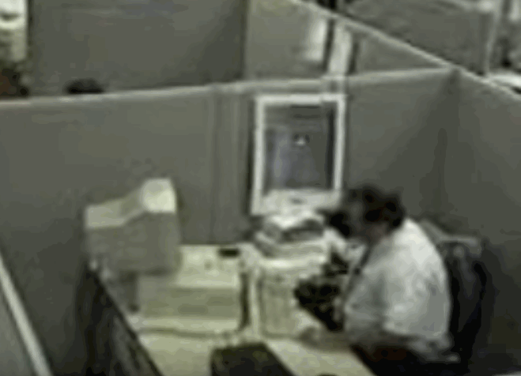
“Can you validate documentation?”
Smart Admin
Admin from the past

Slide 11
DevOps, Infra as code, (insert more buzzwords here)
Here comes the real stuff!

Slide 12
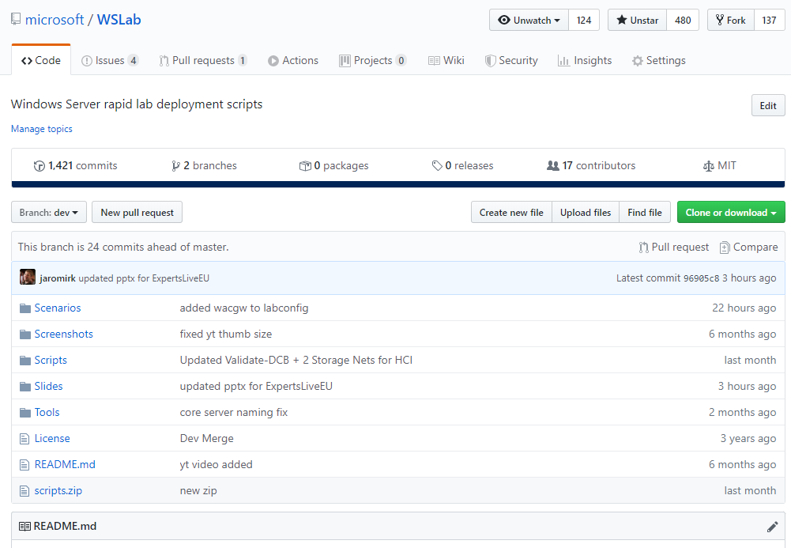
WSLab Scenarios

Slide 13
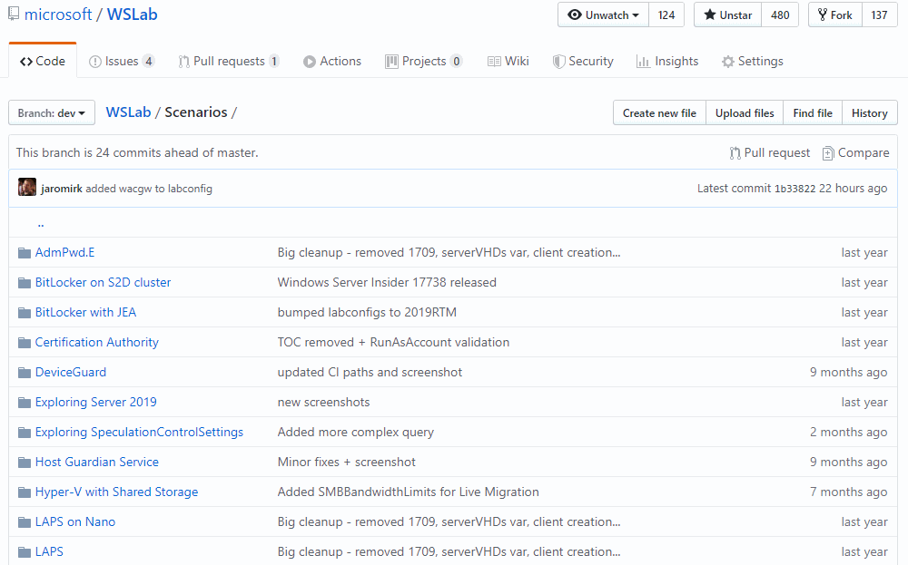
WSLab Scenarios

Slide 14
Complex scenarios

Slide 15
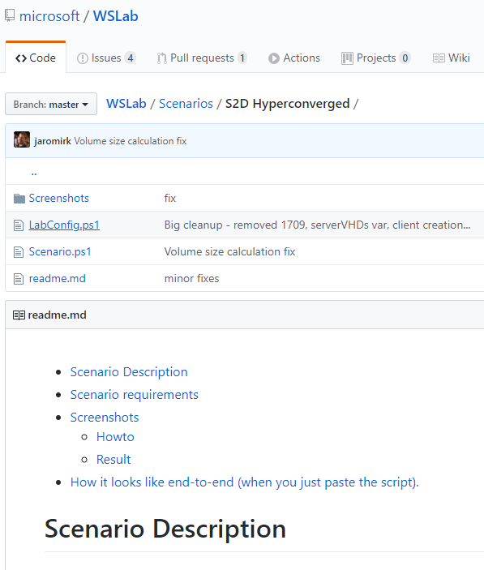
Complex scenarios
Contains scenario.ps1
Also contains some description
Scenario.ps1 contains regions
You can run all, or study/run block by block
S2D Hyperconverged
S2D Converged
S2D and SCVMM Bare metal
…..
Complex scenarios don’t have guide
It’s too long, too complex

Slide 16
S2D Hyperconverged
Simulates 2-16 nodes
Time to deploy ~30 minutes
Can run nested VMs
To play with LM
Contains ALL best practices
If not, ping me!

Slide 17
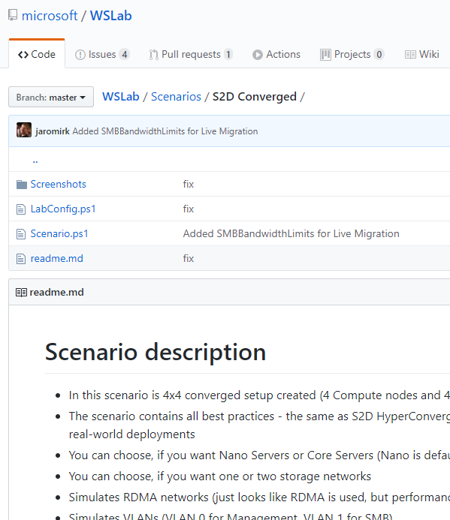
S2D Converged
Simulates 2-16 storage and 2-64 compute nodes
Demonstrates scaling up from 4x4 to 5x5
Following is the same as HCI
Time to deploy ~30 minutes
Can run nested VMs
To play with LM
Contains ALL best practices
If not, ping me!

Slide 18
Guided scenarios

Slide 19
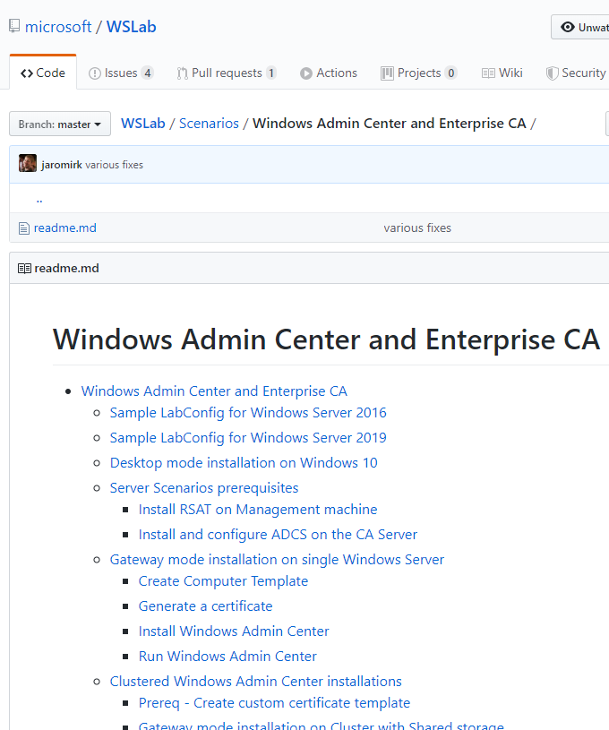
Guided Scenarios
All “S2D and …” and some others
I was not lazy and I wrote guide
Starts with Labconfig and Prereq
Contains screenshots, so you don’t need to spin WSLab, and just read

Slide 20
Demo

Slide 21
Wrap-up

Slide 22
Wrap-up
Learn PowerShell by following (and recycling) Scenarios
Feel free to steal ideas – WSLab is free!
The future of WSLab
Well, it’s my side (night) project.
Is it the right way for documentation? You decide!

Slide 23














Thank you Sponsors!

